Slide 1
My Dashboards
Minita Nilesh Bhatt
Tableau

Slide 2
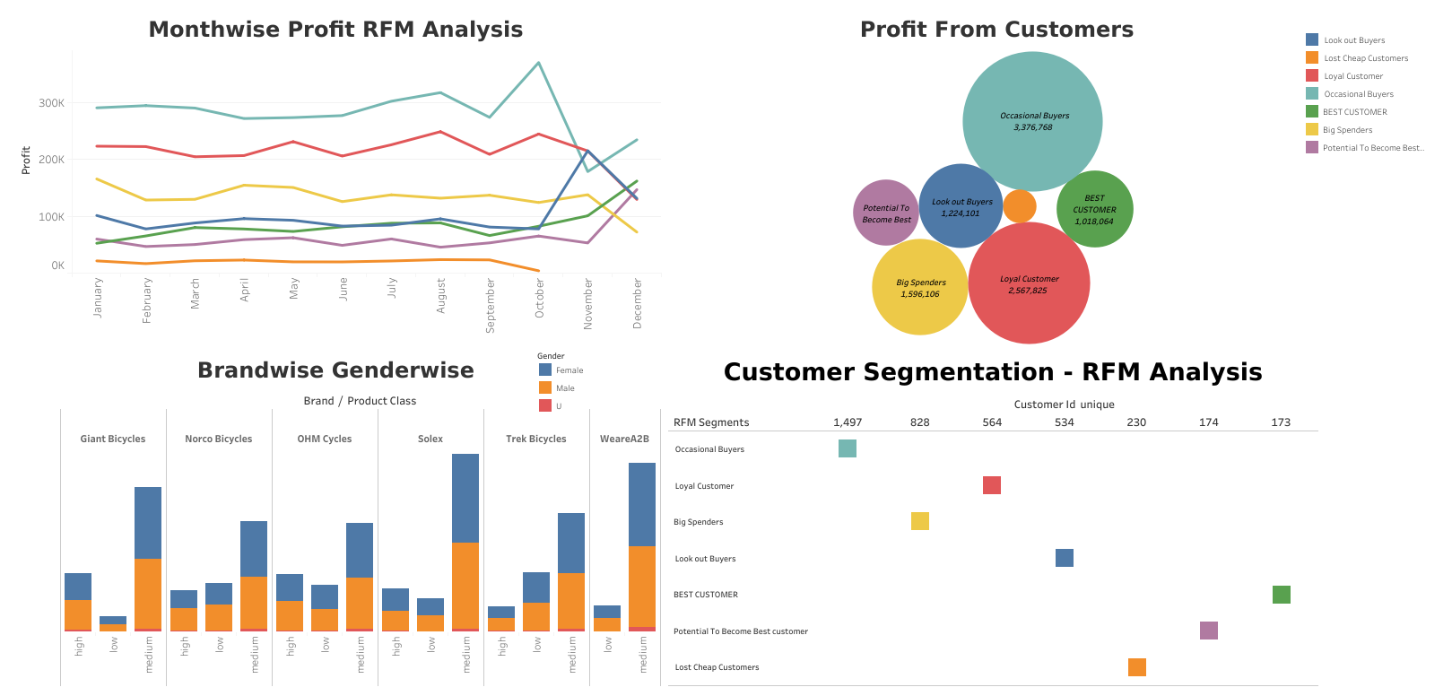
KPMG RFM Analysis

Slide 3
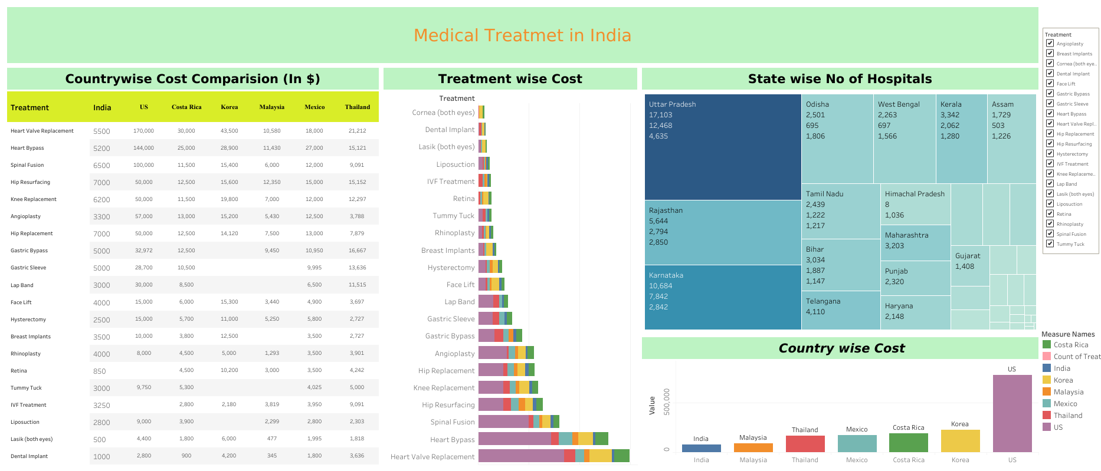
Medical Tourism In India

Slide 4
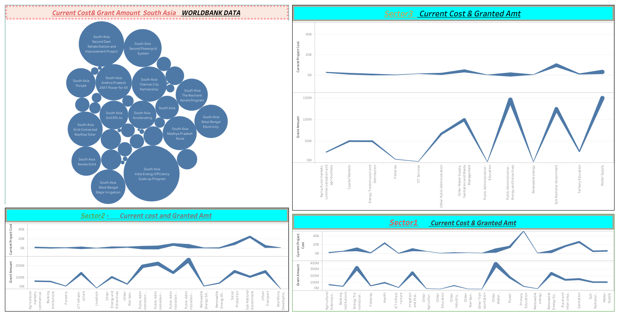
ASIA -INDIA Republic WB Grant

Slide 5
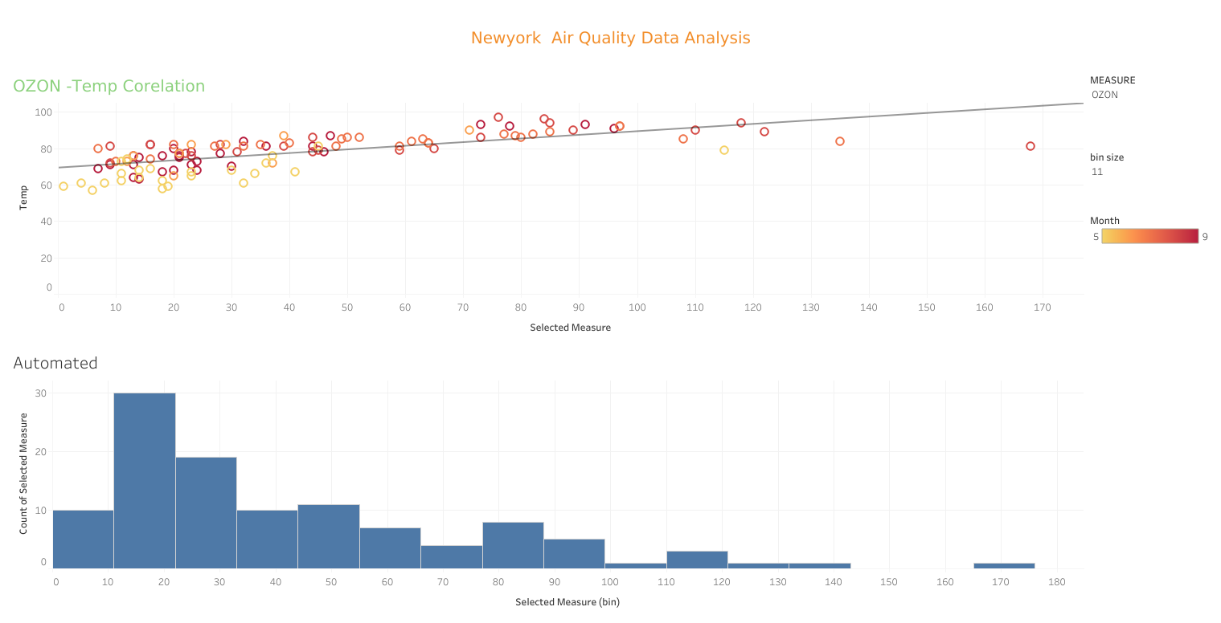
New york Air Quality Data Analysis

Slide 6
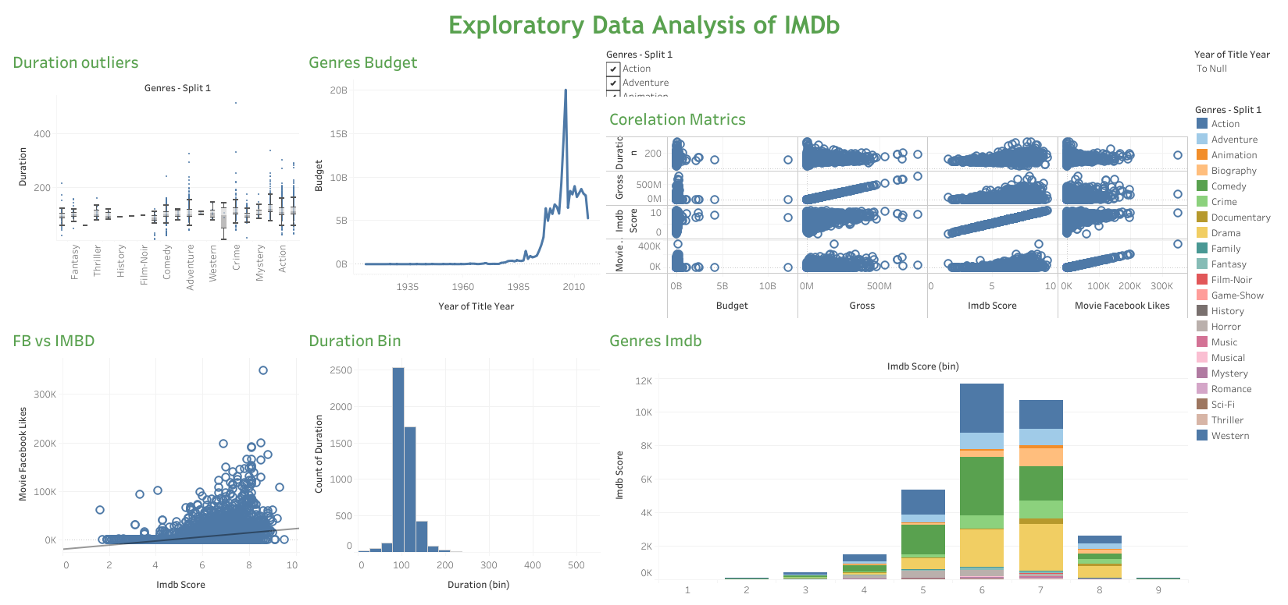
Exploratory DA of IMDb

Slide 7
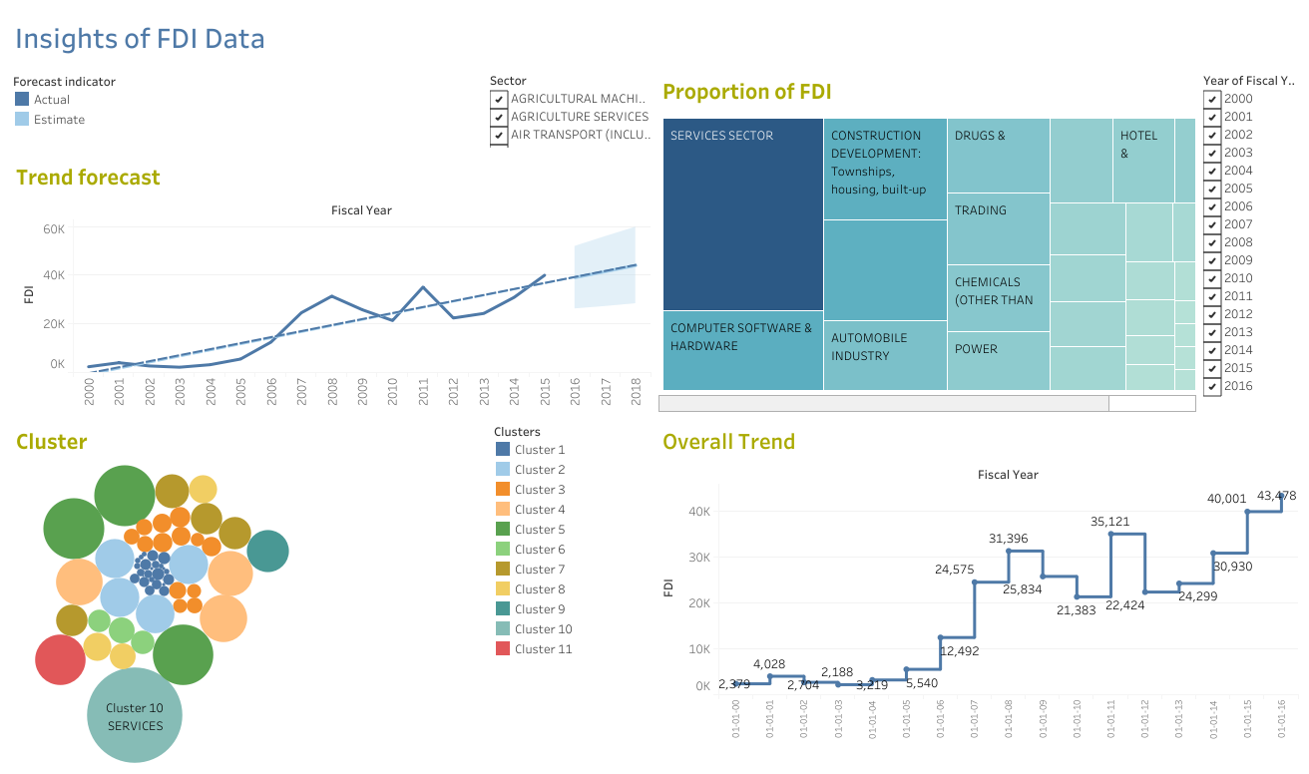
Insights of FDI

Slide 8
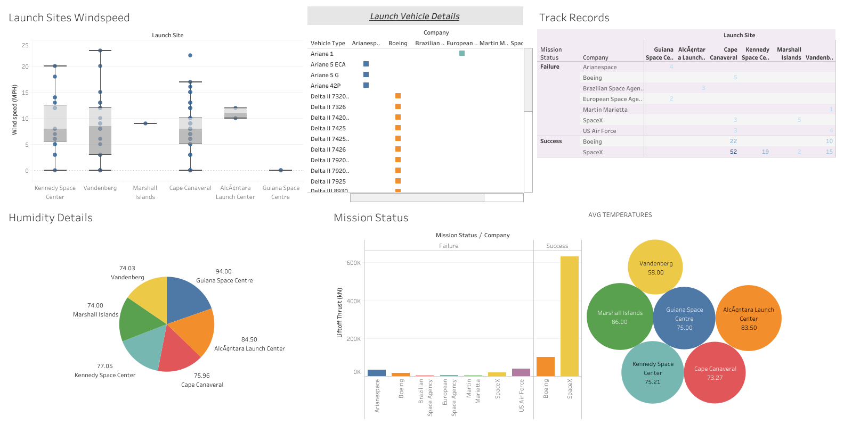
Space Mission Data

Slide 9
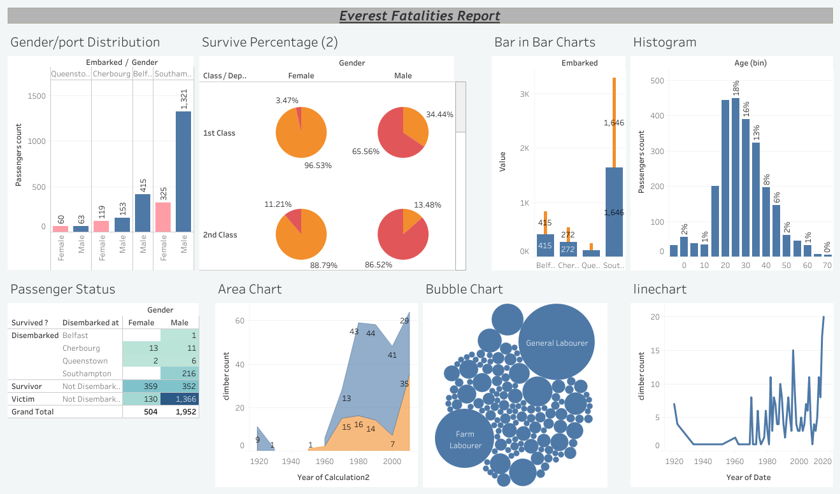
Everest Fatalities Report

Slide 10
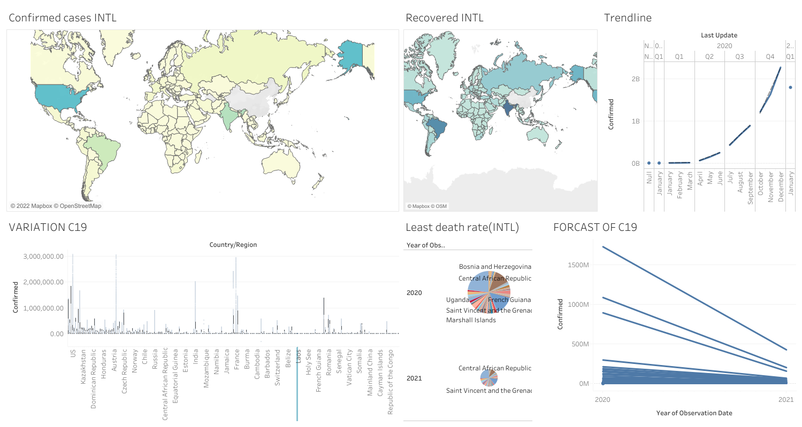
Covid 19 INTL & INDIA

Slide 11
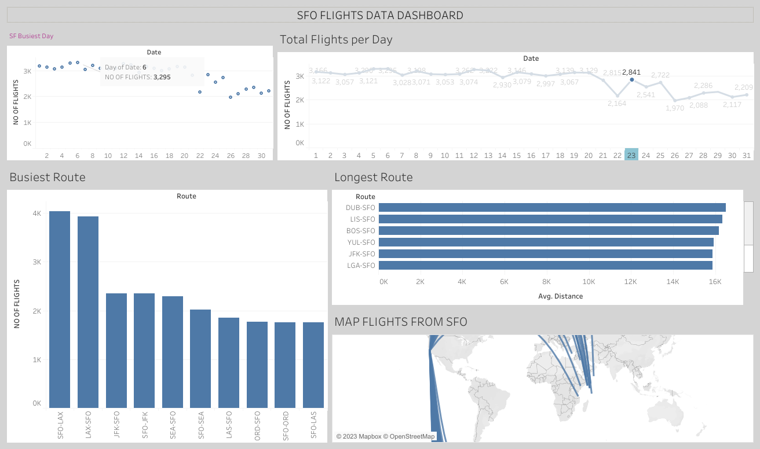
SFO Flight Frequency Data

Slide 12
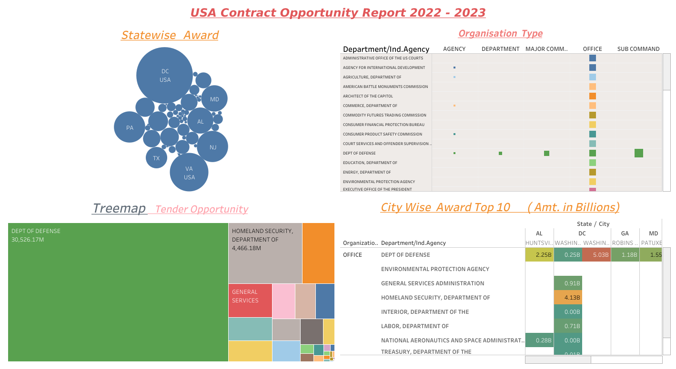
USA Tender Opportunity23

Slide 13
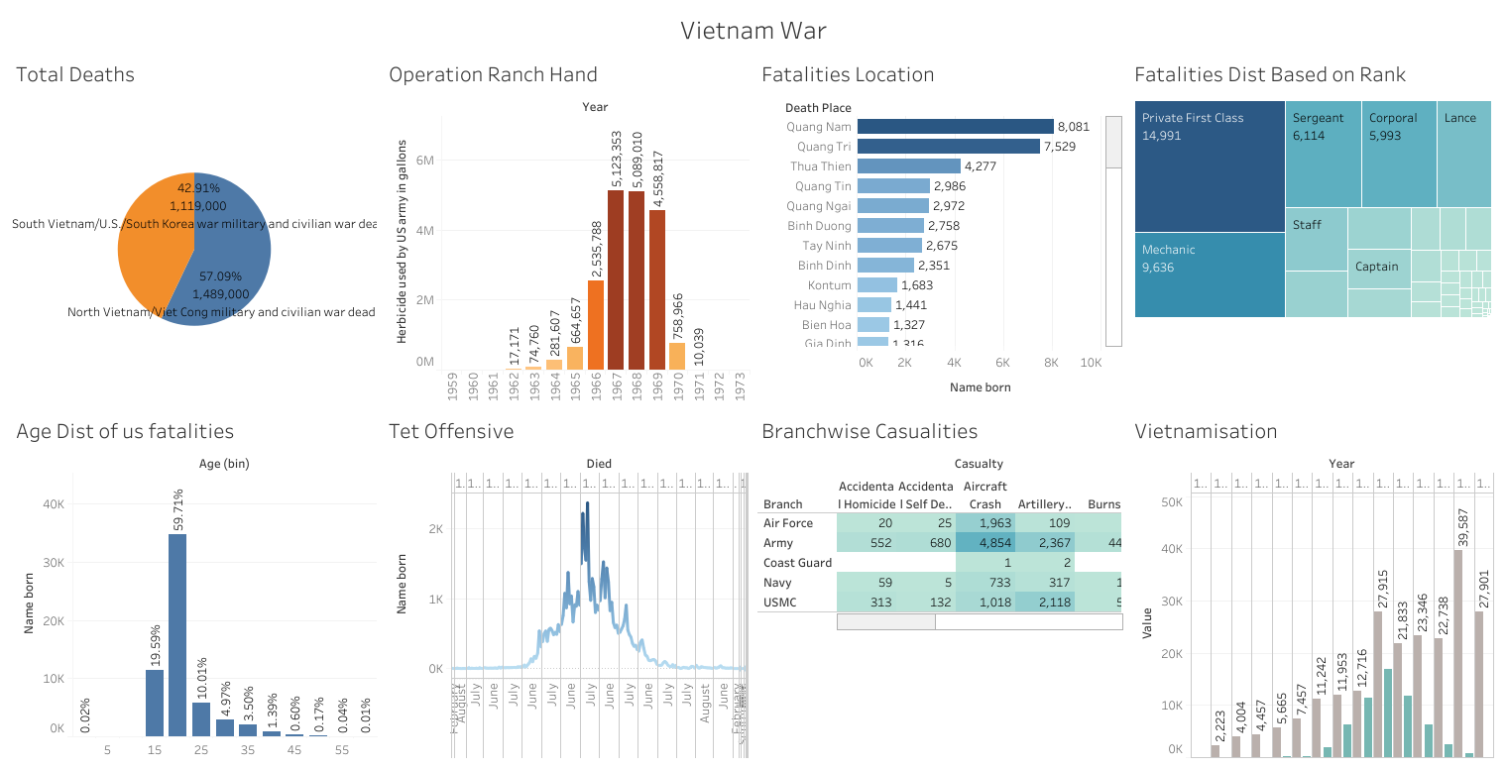
Vietnam war Fatalities

Slide 14
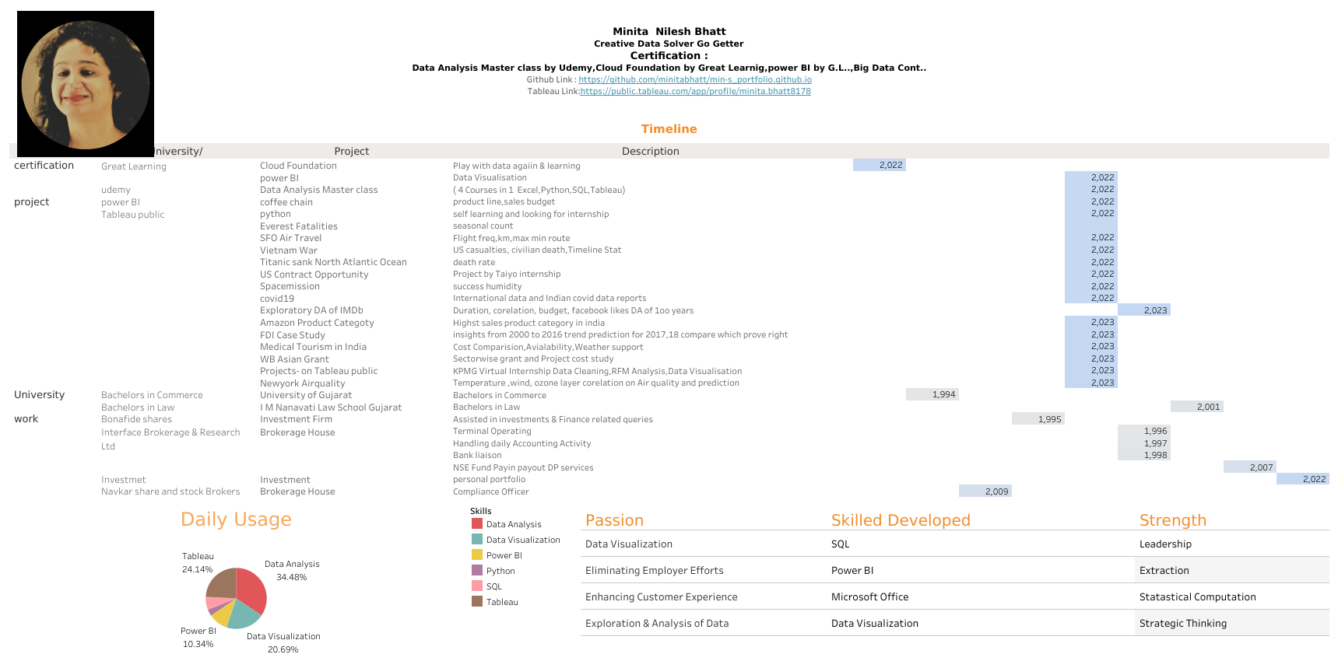
Resume.MNB.23

